Slide 1
Embedded I/O

Slide 2
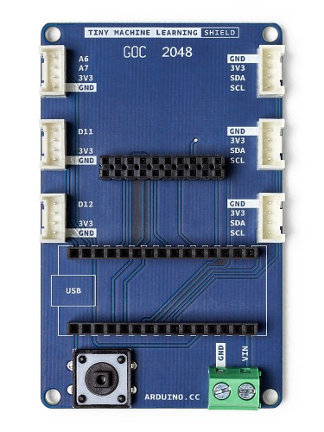

Slide 3
GPIO Pins
I2C Interface
Notes:
coulomb counters accurately measure and report battery capacity in single cell or multicell handheld applications.

Slide 4
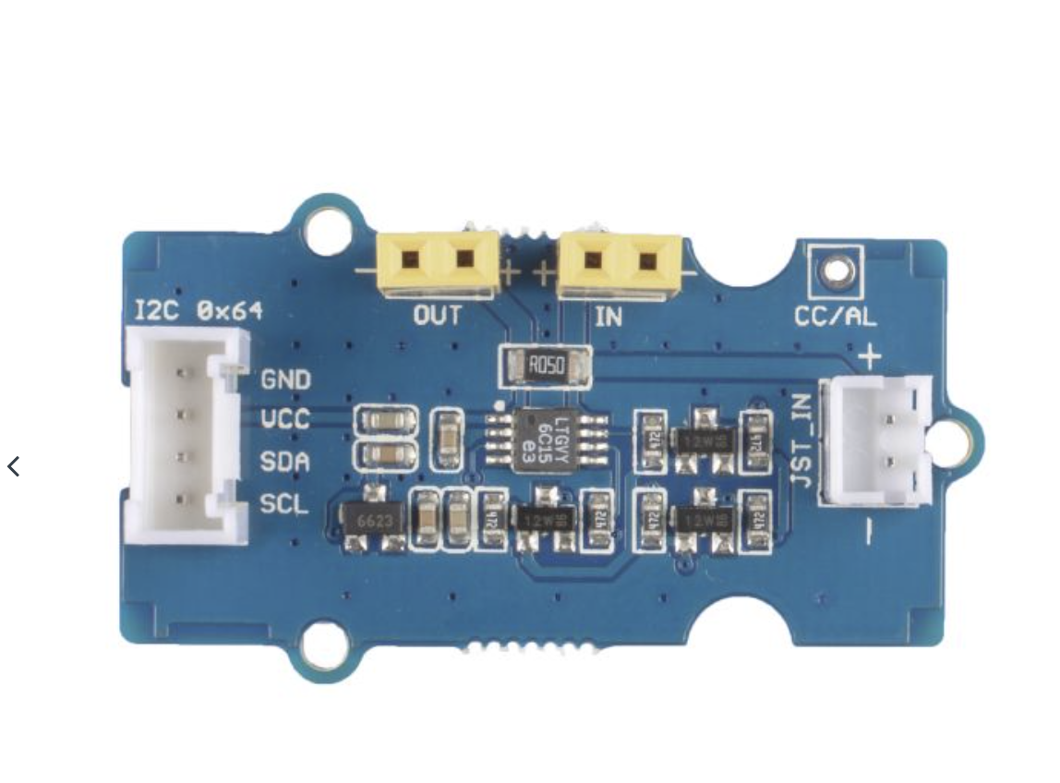
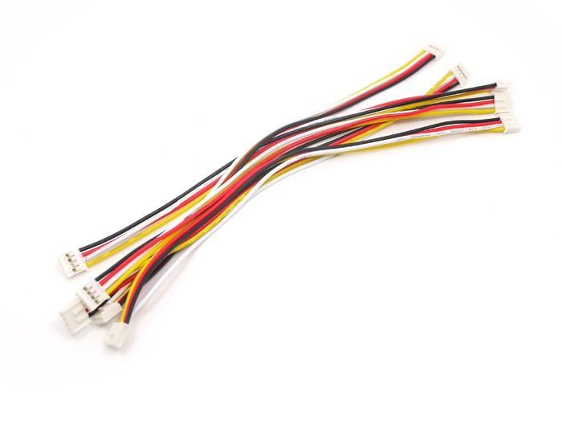
GPIO Pins
I2C Interface
Notes:
coulomb counters accurately measure and report battery capacity in single cell or multicell handheld applications.

Slide 5
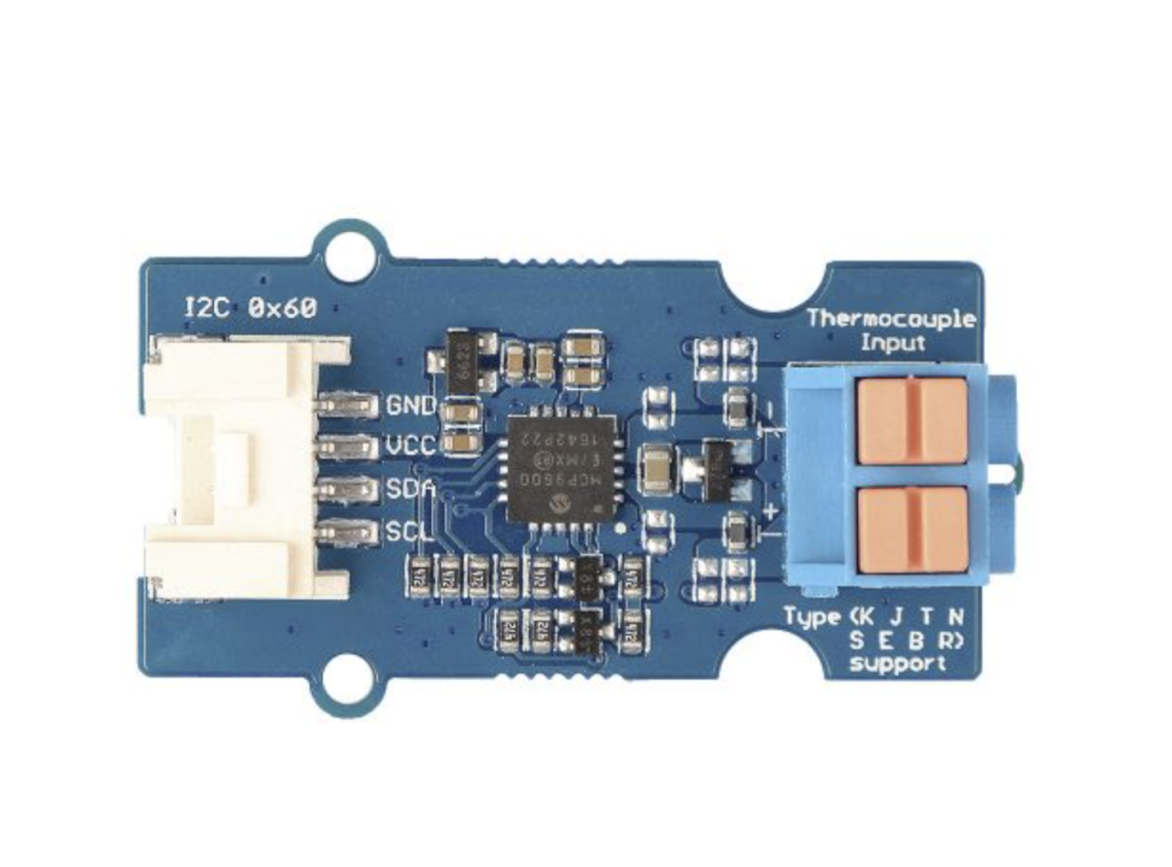
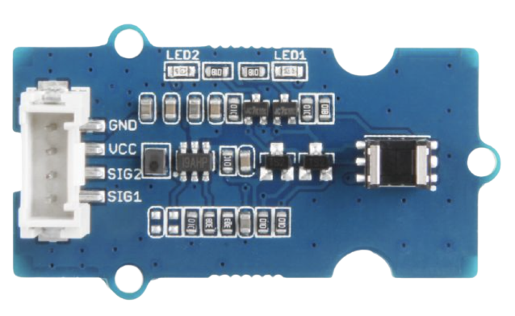
Systems Engineering—Module Integration
Thermocouple Amp
Coulomb Counter
Rotary Encoder
Grove Sensors
Large catalog of sensors, actuators available at seeedstudio.com
Notes:
Thermocouple amp: https://www.seeedstudio.com/Grove-I2C-Thermocouple-Amplifier-MCP9600.html
Coulomb counter: https://www.seeedstudio.com/Grove-Coulomb-Counter-3-3V-to-5V-LTC2941.html
Rotary encoder: https://www.seeedstudio.com/Grove-Optical-Rotary-Encoder-TCUT1600X01.html

Slide 6
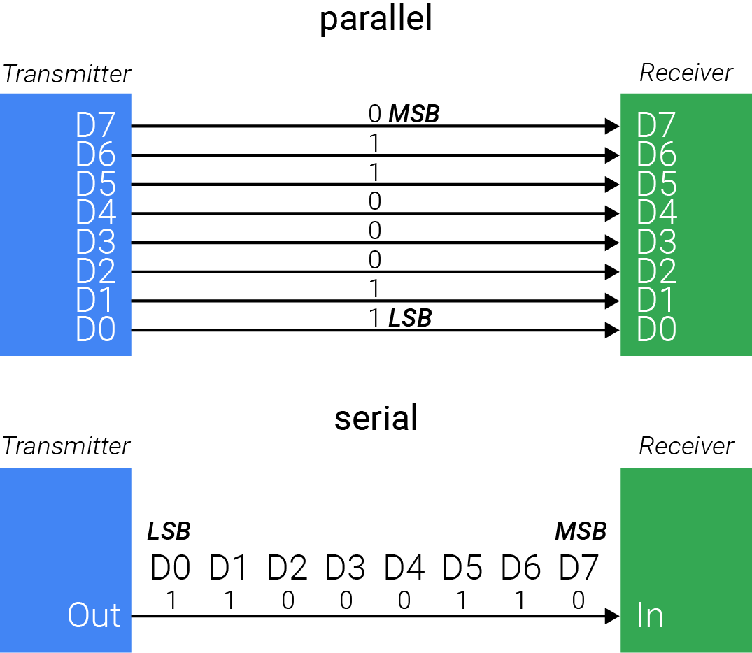
Method of Communication
MSB → most significant bit
LSB → least significant bit
Option 1: use parallel interface to connect elements

Slide 7
Method of Communication
MSB → most significant bit
LSB → least significant bit
Option 2: use serial interface to transmit binary data in sequence
This approach reduces number of wires

Slide 8
Serial Communication Protocols
UART
universal asynchronous
receive-transmit
no shared clock
for synchronicity
slower
simple wiring
I2C
inter-integrated circuit
shared clock
intermediate speed
bi-directional
but one-at-a-time
simple wiring
SPI
serial peripheral interface
shared clock
high transfer speed
simultaneous
full duplex
complex wiring

Slide 9
Serial Communication Protocols
UART
universal asynchronous
receive-transmit
no shared clock
for synchronicity
slower
simple wiring
I2C
inter-integrated circuit
shared clock
intermediate speed
bi-directional
but one-at-a-time
simple wiring
SPI
serial peripheral interface
shared clock
high transfer speed
simultaneous
full duplex
complex wiring

Slide 10
Inter-Integrated Circuit (I2C)
SDA is the serial data channel SCL is the serial clock channel
Vs
pull-up
resistors
SDA
SCL

Slide 11
Inter-Integrated Circuit (I2C)
SDA is the serial data channel SCL is the serial clock channel
Bus permits addressing of ‘sons’
Vs
pull-up
resistors
SDA
SCL
mother
son x
son y
set address to son of interest

Slide 12
Inter-Integrated Circuit (I2C)
SDA is the serial data channel SCL is the serial clock channel
Bus permits addressing of ‘sons’
Two modes of operation Mother-transmitter, son-receiver Son-transmitter, mother-receiver
Vs
pull-up
resistors
SDA
SCL
mother
son x
son y
set address to son of interest

Slide 13
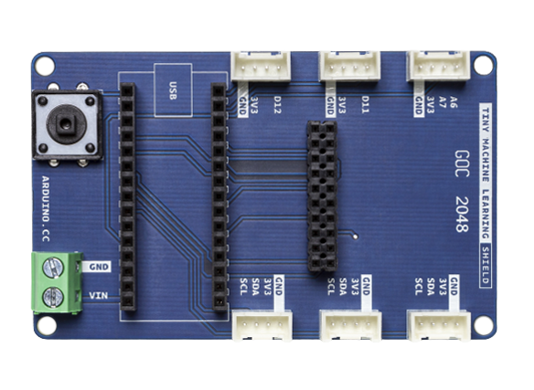
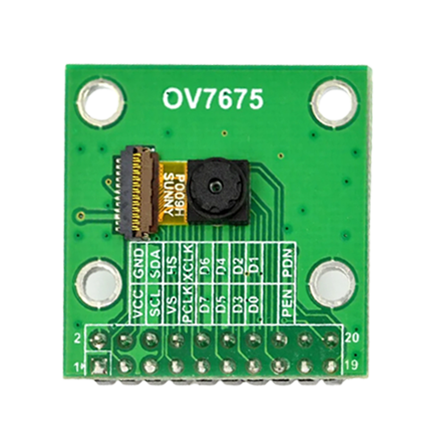
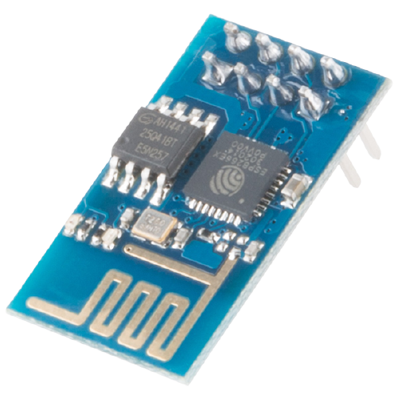
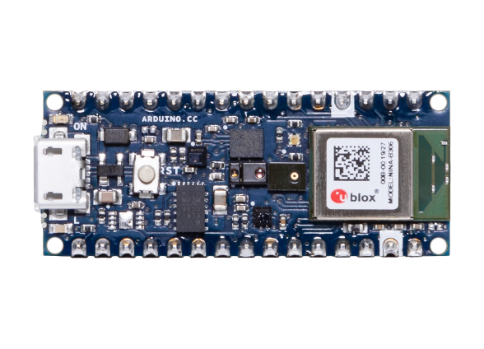
Vs
pull-up
resistors
SDA
SCL
Notes:
https://commons.wikimedia.org/wiki/File:WiFi_Module_-_ESP8266_(16730689880).jpg

Slide 14
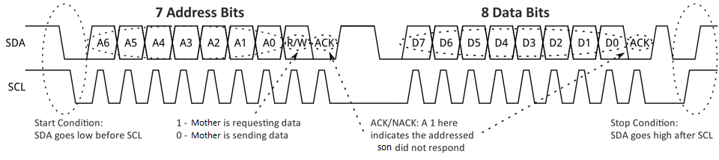
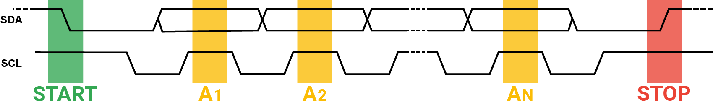
START
ADDRESS
R/W
ACK
DATA
ACK
DATA
ACK
STOP
Notes:
https://commons.wikimedia.org/wiki/File:I2C_data_transfer.svg
Start: SDA goes low before SCL
Stop SDA goes high after SCL

Slide 15
START
ADDRESS
R/W
ACK
DATA
ACK
DATA
ACK
STOP
Notes:
https://commons.wikimedia.org/wiki/File:I2C_data_transfer.svg
Start: SDA goes low before SCL
Stop SDA goes high after SCL

Slide 16
START
ADDRESS
R/W
ACK
DATA
ACK
DATA
ACK
STOP
Notes:
https://commons.wikimedia.org/wiki/File:I2C_data_transfer.svg
Start: SDA goes low before SCL
Stop SDA goes high after SCL

Slide 17
START
ADDRESS
R/W
ACK
DATA
ACK
DATA
ACK
STOP
Notes:
https://commons.wikimedia.org/wiki/File:I2C_data_transfer.svg
Start: SDA goes low before SCL
Stop SDA goes high after SCL

Slide 18
START
ADDRESS
R/W
ACK
DATA
ACK
DATA
ACK
STOP
Notes:
https://commons.wikimedia.org/wiki/File:I2C_data_transfer.svg
Start: SDA goes low before SCL
Stop SDA goes high after SCL

Slide 19
START
ADDRESS
R/W
ACK
DATA
ACK
DATA
ACK
STOP
Notes:
https://commons.wikimedia.org/wiki/File:I2C_data_transfer.svg
Start: SDA goes low before SCL
Stop SDA goes high after SCL

Slide 20
START
ADDRESS
R/W
ACK
DATA
ACK
DATA
ACK
STOP
Notes:
https://commons.wikimedia.org/wiki/File:I2C_data_transfer.svg
Start: SDA goes low before SCL
Stop SDA goes high after SCL

Slide 21
START
ADDRESS
R/W
ACK
DATA
ACK
DATA
ACK
STOP
Notes:
https://commons.wikimedia.org/wiki/File:I2C_data_transfer.svg
Start: SDA goes low before SCL
Stop SDA goes high after SCL

Slide 22
START
ADDRESS
R/W
ACK
DATA
ACK
DATA
ACK
STOP
Notes:
https://commons.wikimedia.org/wiki/File:I2C_data_transfer.svg
Start: SDA goes low before SCL
Stop SDA goes high after SCL

Slide 23
START
ADDRESS
R/W
ACK
DATA
ACK
DATA
ACK
STOP
Notes:
https://commons.wikimedia.org/wiki/File:I2C_data_transfer.svg
Start: SDA goes low before SCL
Stop SDA goes high after SCL

Slide 24
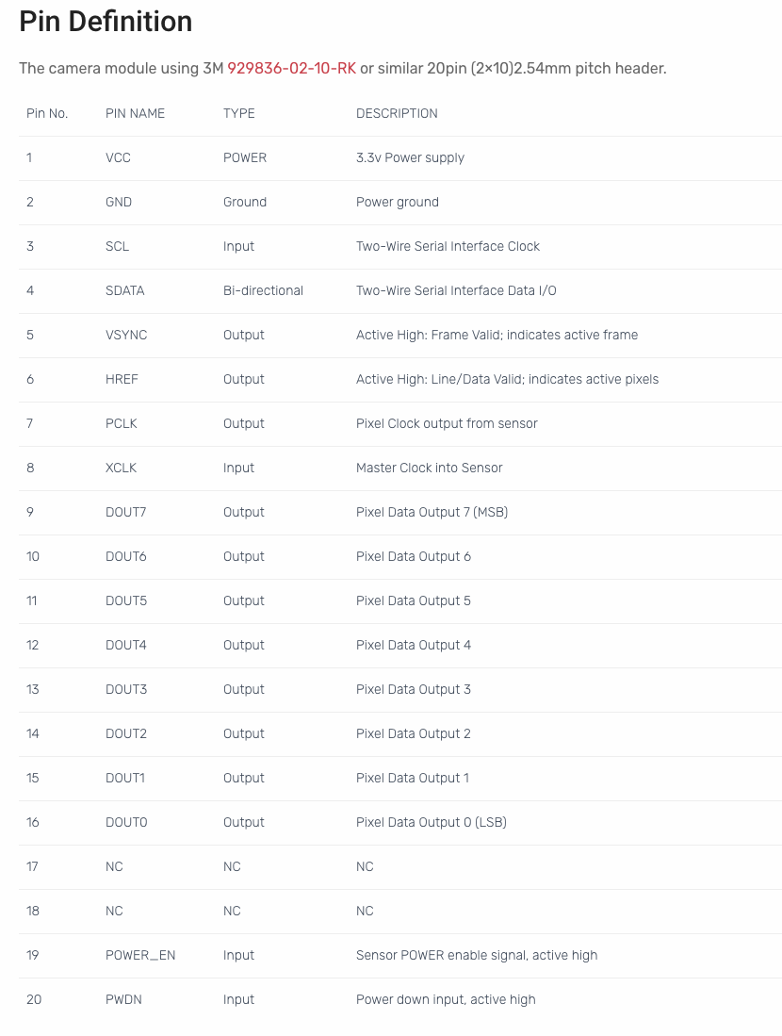
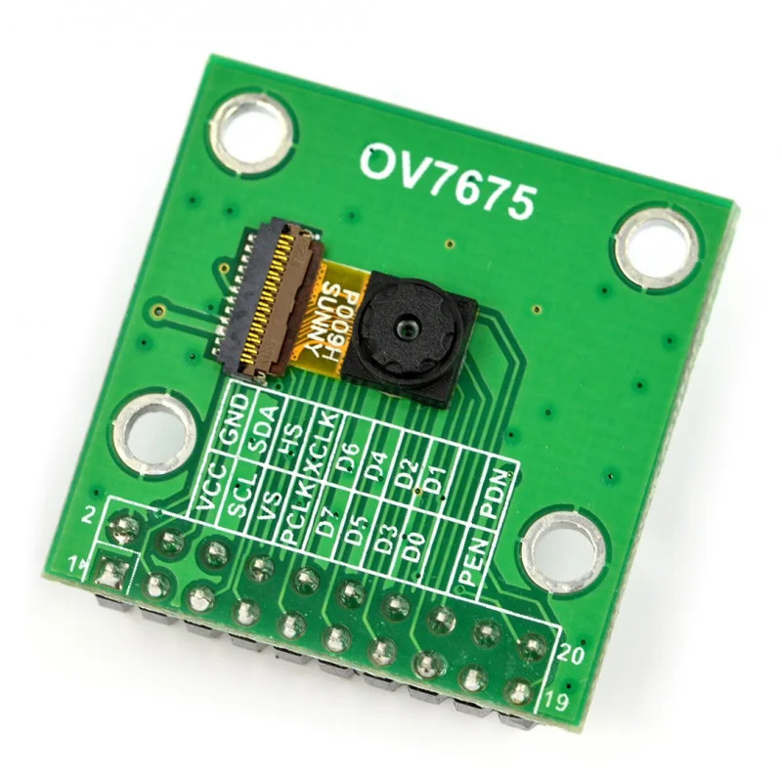
I²C in action

Slide 25
I²C in action

Slide 26
I²C in action

Slide 29
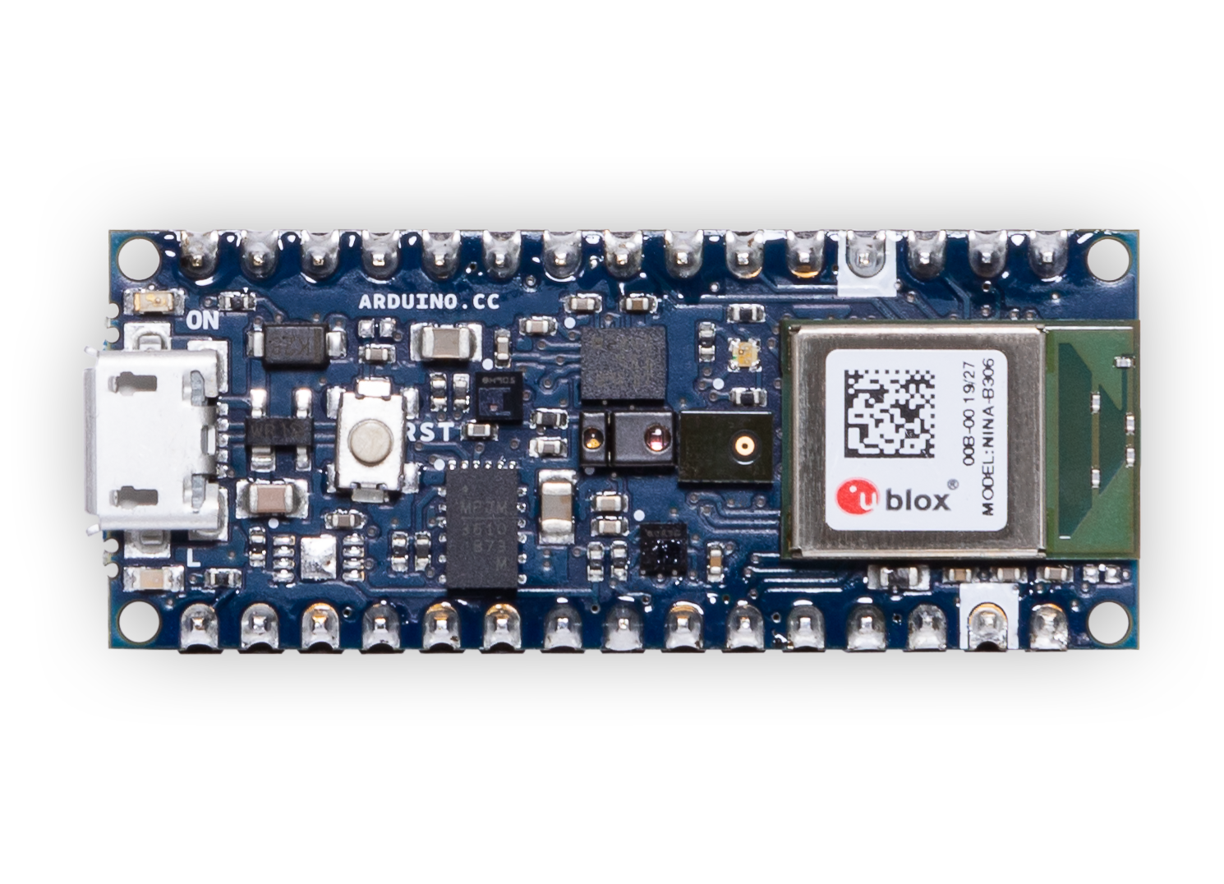
I²C in action
IMU
Processor
+ Bluetooth
Notes:
IMU + MCU
From (https://docs.google.com/presentation/d/1tbpl20_NoXxZ0MOSd4og8KnuRs-BxugEhMzBt0F-a68/edit#slide=id.gb6443ea274_0_284)

Slide 30
